Slide 1
Microservices with OpenShift

Slide 2
Objectives
After watching this video, you will be able to:
• Describe how OpenShift makes developers' lives
easier
• Explain the process by which microservices are
deployed on OpenShift

Slide 3
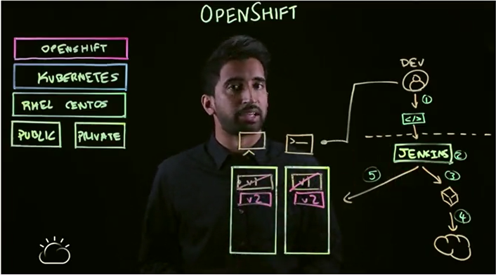
Microservices with OpenShift

Slide 4
Summary
In this video, you learned that:
• OpenShift creates a Jenkins job to
automatically build microservices into
containers
• OpenShift pushes the built containers to a
registry and deploys those containers to the
cluster

